Slide 1
Chapter 6 Heapsort
Guangyu Zou
gyzou@dlut.edu.cn
Dalian University of Technology

Slide 2
Outline
Problems
Designing solution strategies
Developing algorithms
Writing algorithms that implement the strategies
Understand existing algorithms and modify/reuse
Understanding an algorithm by simulating its operation on an input
Ensuring/proving correctness
Analyzing and comparing performance/efficiency
Theoretically: Using a variety of mathematical tools
Empirically: Code, run and collect performance data
Choosing the best

Slide 3
Sorting algorithm
Insertion, Bubble, Selection sorts:
Non-recursive
In place: only a constant number of additional storage locations (for local variables) are used outside the array.
Merge sort :
Recursive; Not in place.
Heap sort : (Chapter 6)
Non-recursive
In place
Sorts n numbers in place in O(nlgn)

Slide 4
Sorting algorithm
Quick sort : (chapter 7)
Recursive
In place
Worst time complexity O(n²); Average time complexity O(n logn)
Fastest general purpose sorting algorithm
Linear sorting algorithms : (chapter 8)
Counting sort
Radix sort
Bucket Sort

Slide 5

Insertion Sort

Slide 6

Bubble Sort

Slide 7
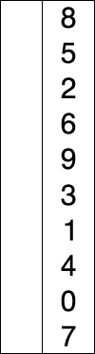
Selection Sort

Slide 8
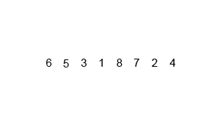

Merge Sort

Slide 9
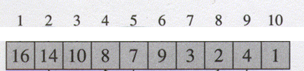


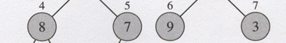
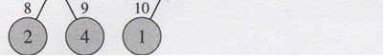
Heaps (Binary heap)
The binary heap data structure is an array object that can be viewed as a complete tree.
Parent(i)
return
LEFT(i)
return 2i
Right(i)
return 2i+1

Slide 10
Heap property
Max-heap : A [parent(i)] ≥ A[i]
Min-heap : A [parent(i)] ≤ A[i]
The height of a node in a tree: the number of edges on the longest downward path from the node to a leaf.
The height of a tree: the height of the root
The height of a heap: floor(lg n)=O(lg n).
Notes:
Compare with BST
Ask minimum or maximum

Slide 11
Basic algorithms on max heap
Max-Heapify algorithm
Build-Max-Heap algorithm
Heapsort algorithm
Heap-Extract-Max algorithm
Heap-Maximum algorithm
Max-Heap-Increase-Key algorithm
Max-Heap-Insert algorithm

Slide 12
Basic algorithms on max heap
Max-Heapify algorithm
Build-Max-Heap algorithm
Heapsort algorithm
Heap-Extract-Max algorithm
Heap-Maximum algorithm
Max-Heap-Increase-Key algorithm
Max-Heap-Insert algorithm

Slide 13
Maintaining the heap property
Max-Heapify is an important subroutine for manipulating heaps. Its inputs are an array A and an index i in the array. When Heapify is called, it is assumed that the binary trees rooted at LEFT(i) and RIGHT(i) are heaps, but that A[i] may be smaller than its children, thus violating the max heap property.

Slide 14
Max-Heapify (A, i)
1 l ←2i
2 r ←2i+1
3 if l ≤ heap-size(A) and A[l] > A[i]
4 then largest ← l
5 else largest ← i
6 if r ≤ heap-size[A] and A[r] > A[largest]
7 then largest ← r
8 if largest ≠ i
9 then exchange A[i] ↔ A[largest]
10 Max-Heapify (A, largest)
Thinking Assignment: How about Min-Heapify?

Slide 15
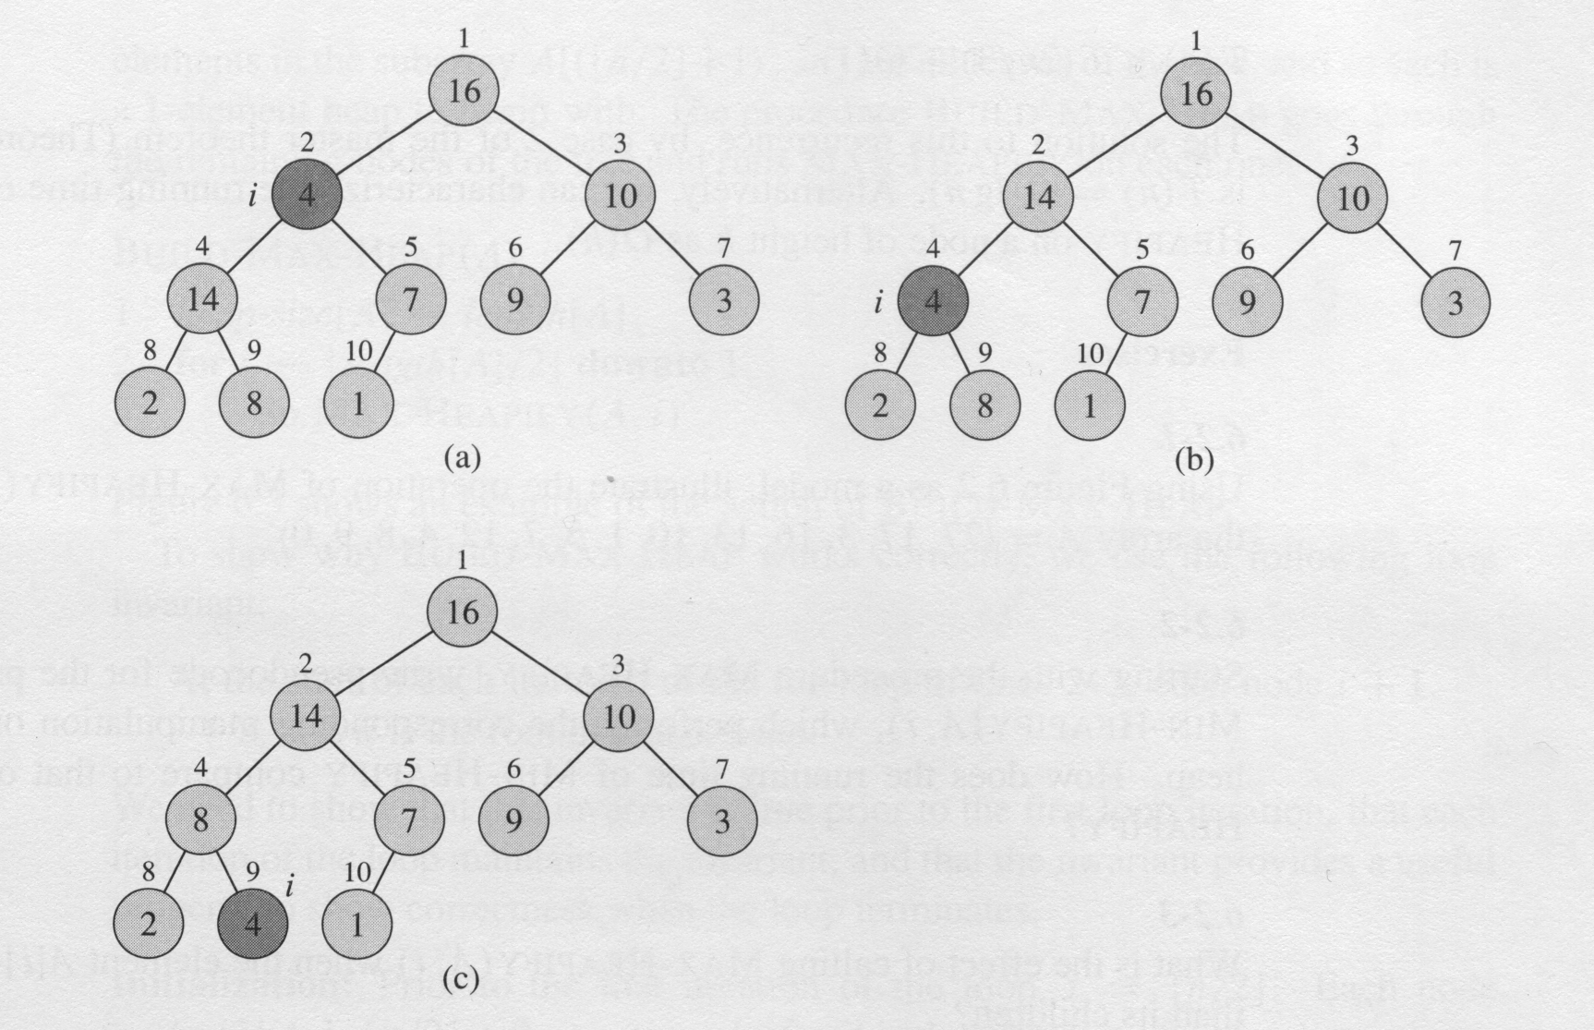
Max-Heapify(A,2) heap-size[A] = 10

Slide 16
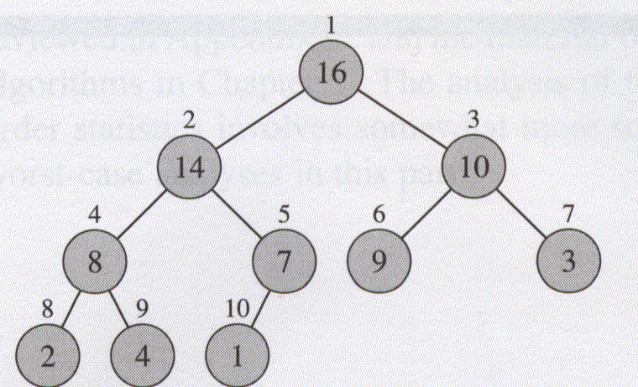
Max-Heapify Complexity
It has to be O(height) – why?
Height of a heap is O(lgn)
So Max-Heapify is O(lgn)
Alternately
What is the base case?
What are the recurrence relations?
These can be solved to show T(n)=O(lgn)
Thinking Assignment: Try it!

Slide 17
Building a heap
Build-Max-Heap(A)
1 heap-size(A) ← length(A)
2 for i ← ⎣heap-size(A)/2⎦ downto 1
3 do Max-Heapify(A, i)
Thinking Assignments:
Why does this loop start from ⎣length(A)/2⎦ ?
Why does the loop not go from 1 to ⎣heap-size(A)/2⎦ ?
What is Build-Max-Heap’s complexity?

Slide 18
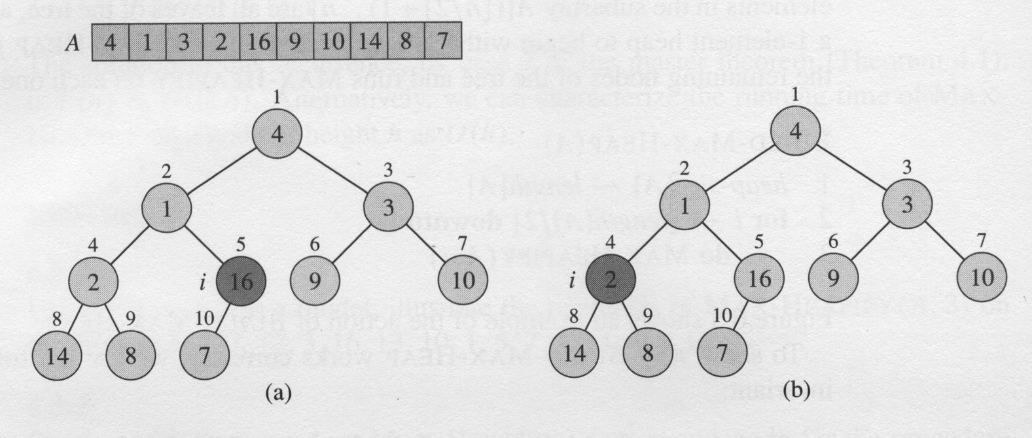
Build-Max-Heap

Slide 19
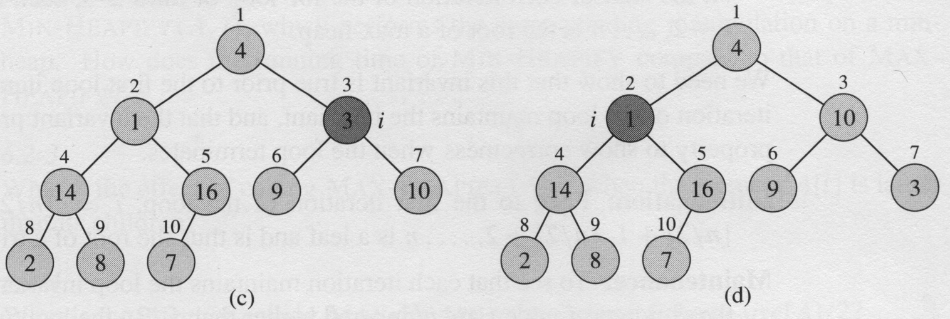
Build-Max-Heap

Slide 20
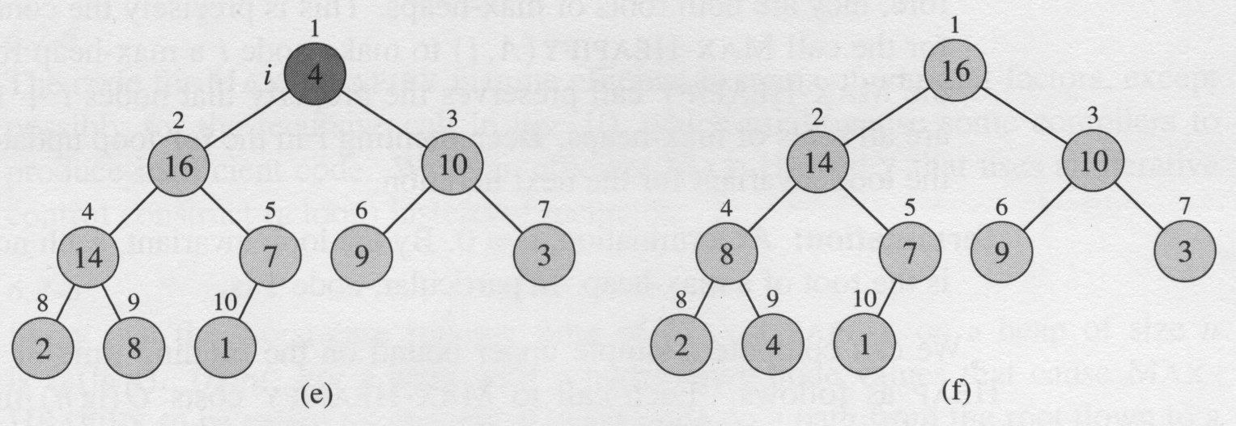
Build-Max-Heap

Slide 21
Time complexity
MAX-HEAPIFY costs O(lgn) and there are O(n) such calls
Thus, the running time is O(n lg n)
Tighter upper bound?

Slide 22
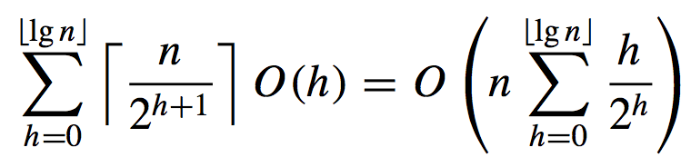
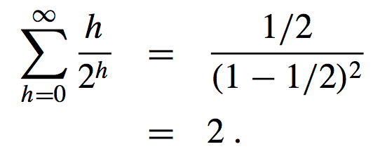
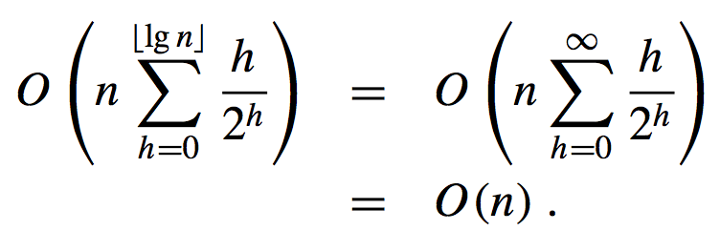
Tighter Upper Bound

Slide 23
The Heapsort algorithm
Heapsort(A)
1 Build-Max-Heap(A)
2 for i ← length(A) down to 2
3 do exchange A[1]↔A[i]
4 heap-size[A] ← heap-size[A] -1
Max-Heapify(A,1)
Thinking Assignment:
Does this algorithm sort in ascending order?
What is its complexity?
O(nlgn)

Slide 24
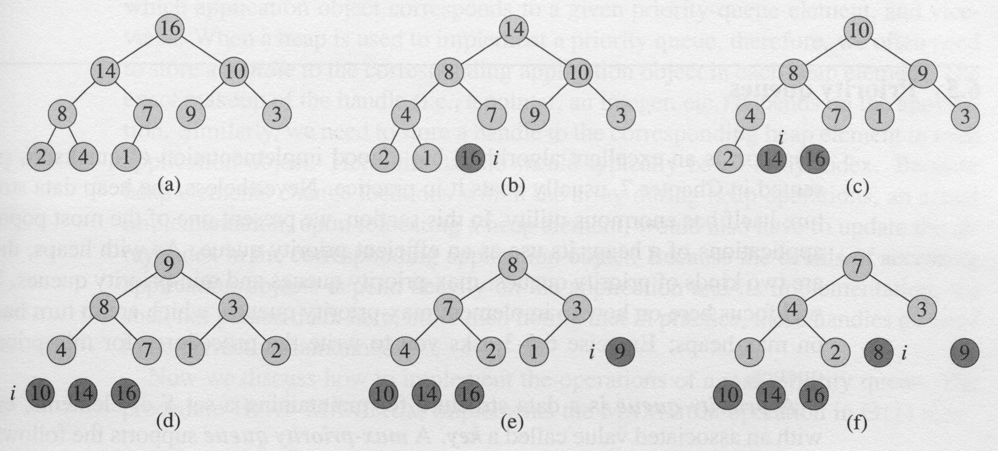
The operation of Heapsort

Slide 25
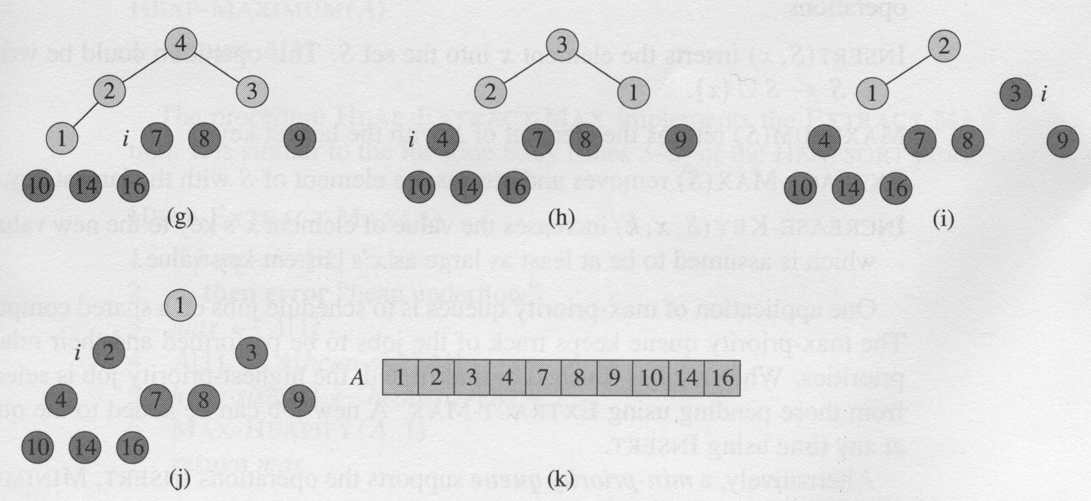
The operation of Heapsort

Slide 26
Priority queues
The heap data structure is not only used in sorting but also in priority queues. A priority queue is a data structure that maintain a set S of elements, each with an associated value call a key. Priority queues has many applications. A max (or min) priority queue should at least support the following operations:
Insert (S, x) O(log n)
Maximum/Minimum (S) O(1)
Extract-Max/Min (S) O(log n)
Increase-Key (S, x, k) O(log n)
Decrease-Key (S, x, k) O(log n)

Slide 27
Two Heap Operations
Heap-Extract-Max(A)
1 if heap-size[A] < 1
2 then error “heap underflow”
3 max ← A[1]
4 A[1] ←A[heap-size(A)]
5 heap-size(A) ← heap-size(A) - 1
6 Max-Heapify (A, 1)
7 return max
Heap-Maximum(A)
1 return A[1]
Thinking Assignment: Write Heap-Extract-Min(A)

Slide 28
Max-Heap-Increase-Key (A, i, key)
1 if key < A[i]
2 then error “new key is smaller than current key”
3 A[i] ← key
4 while i > 1 and A[Parent(i)] < A[i]
5 do exchange A[i] ↔ A[Parent(i)]
i ← Parent(i)
Thinking Assignment:
What is this algorithm’s complexity?
Write Max-Heap-Decrease-Key (A, i, key)
Write Min-Heap-Increase-Key (A, i, key)
Min-Heap-Decrease-Key (A, i, key)

Slide 29
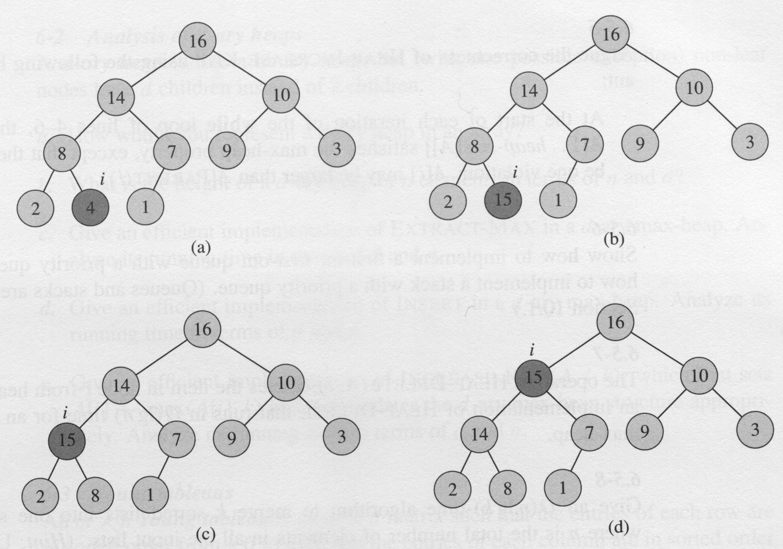
Heap-Increase-Key

Slide 30
Max-Heap-Insert(A, key)
1 heap-size(A) ← heap-size(A) + 1
2 A[heap-size(A)] ← -∞
3 Max-Heap-Increase-Key (A, heap-size(A), key)
Thinking Assignment: Write Min-Heap-Insert(A, key)

Slide 31
Application
Maintain the largest n numbers

Slide 32
Thinking Assignments
Min-Heapify
Build-Min-Heap
Heapsort procedure using a Min heap
Heap-Extract-Min
Heap-Minimum
Min-Heap-Decrease-Key
Min-Heap-Insert
Max-Heap-Decrease-Key
Min-Heap-Increase-Key

Slide 33
Summary
Max-Heapify algorithm
Build-Max-Heap algorithm
Heapsort algorithm
Heap-Extract-Max algorithm
Heap-Maximum algorithm
Max-Heap-Increase-Key algorithm
Max-Heap-Insert algorithm

